Slide 1
Introduction to Deep Learning:
Neural Networks and Applications

Slide 2
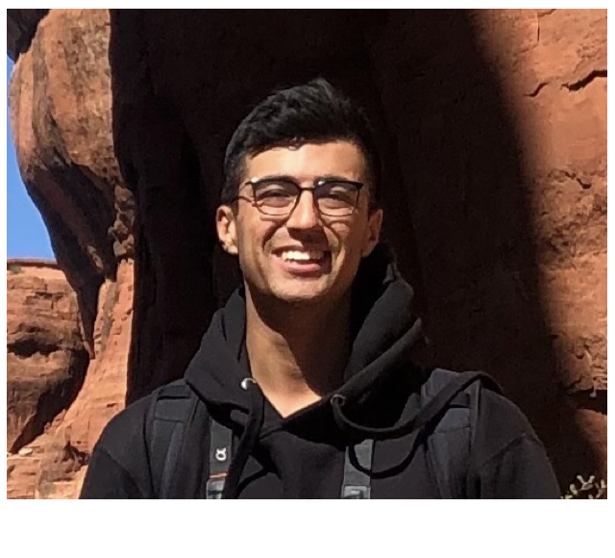
Instructor
Hunter Buckhorn
Machine Learning Engineer
Procore Technologies
Specialized in Math, Stats, and Computer Science
At University of California Santa Barbara
Current focus in Computer Vision applications in Construction:
Deep Learning:
Image Classification, Object Detection, Instance/Semantic Segmentation
OCR for document information extraction

Slide 3
Course Goals and Organization
Cover theory of computation and research environment around field of neural networks
Biological motivation
Origins with simple “neurons” and network types
Backpropagation + Mathematical relationship to graph
Multi-layer networks
Types of Networks
Applications

Slide 4
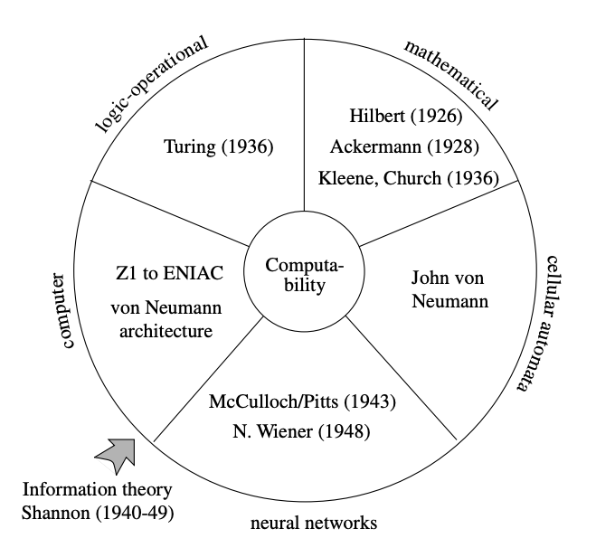
Historical Motivation
Models of computation:
Formal definition of computability proposed in 1930’s and 1940’s.
Can categorize the approaches:
Mathematical
Logic operational
Computer
Cellular automata
Biological

Slide 5
Models of Computation: Mathematical
Which functions can be computed? What is the system of computation that defines rules for constructing functions from primitives?
Mathematicians and areas of research:
Turing: solved halting problem, computability of functions
Godel: theory of completeness,
Godel, Hilbert, Kleene: general, primitive, partial recursive functions
μ-recursive functions = functions computable by Turing machines
Church: theory of lambda calculus
Turing Machines, classes of recursive functions, lambda calculus are proved equivalent to each other!
Notes:
Turing halting problem:
Definition: Halting problem is the problem of determining, from a description of an arbitrary computer program and an input, whether the program will finish running, or continue to run forever.
Proved that a general algorithm to solve the halting problem cannot exist
Godel incompleteness:
No set of axioms and algorithm exists such that all statements about natural numbers can be proven, there will be statements that are true, but that cannot be proven in the system.
Primitive recursive functions
Recursive functions:
Lambda Calculus:
Formal system in mathematical logic for expressing computation based on function abstraction, this formal was used by Church to talk about effectively computable functions
Turing also talked about lambda calculus when relating Turing Machines to recursive functions

Slide 6
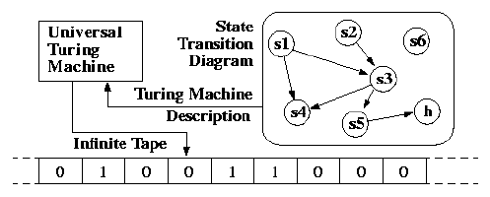
Models of Computation: Logic Operational
Turing: computable functions are those which can be computed with a Turing Machine. Completely different construction than from the theory of recursive functions
Formally: A function on the natural numbers can be calculated by an effective method if and only if it is computable by a Turing Machine
Notes:
Turing halting problem:
Definition: Halting problem is the problem of determining, from a description of an arbitrary computer program and an input, whether the program will finish running, or continue to run forever.
Proved that a general algorithm to solve the halting problem cannot exist
Godel incompleteness:
No set of axioms and algorithm exists such that all statements about natural numbers can be proven, there will be statements that are true, but that cannot be proven in the system.

Slide 7
Models of Computation: Computer
Computer:
30’s 40’s computers Z1 and Z3 programmable but can’t reach all computable functions. Can process steps but can’t iterate
Mark 1 Harvard: Can iterate a constant number of times (memory constrained) but can’t implement a WHILE loop. (Can compute primitive recursive but not general recursive functions)
ENIAC: Also can’t handle open ended loops due to design
Mark 1 Manchester: Can cover all computable functions! Uses branching and allows programs to modify themselves
Like recursive functions: interested in minimal instruction set and algorithms

Slide 8
Models of Computation: Cellular-Automata
Cellular-Automata: Greek, “self acting, willing, moving” -> notion of computer
John von Neumann: role in defining architecture for sequential processing machines, theory of cellular automata. “Automata” operate in a computing space where all data can be processed simultaneously.
Automaton: States, transitions, input and output
Can show that all computable function (Turing) can be computed with cellular automata

Slide 9
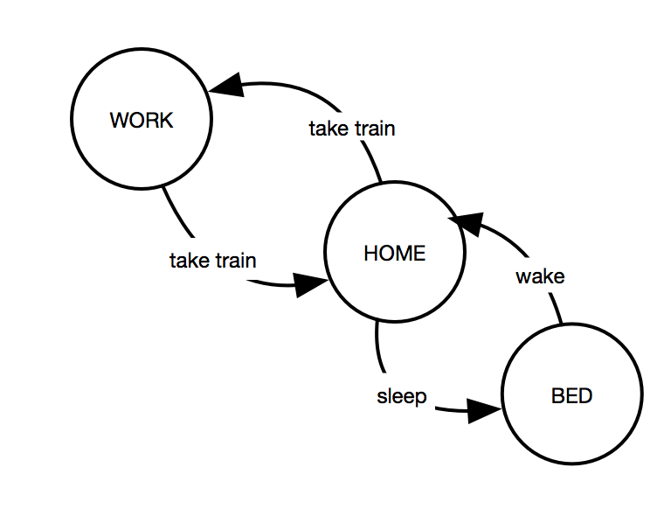
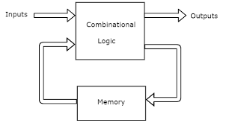
Models of Computation: Cellular-Automata
Cellular Automata:
Turing Machines and Computers

Slide 10
Historical Motivation
Equivalence between different approaches in research:
Mathematical
Logic operational
Computer
Cellular automata
Biological

Slide 11
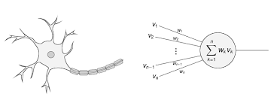
Models of Computation: Biological
Biological:
Explanations of biological systems led to definitions of networks that are unlike current paradigms in previously mentioned fields of study:
Have hierarchical and multi-layered structures in biology
Non-trivial connections and processes

Slide 12
Computing Model
Computing: composition of several paradigms and theories
Storage of information
Transmissions of information
Information processing
Think of previously mentioned theories and their contributions here, in particular, contributions from Turing and Von Neumann

Slide 13
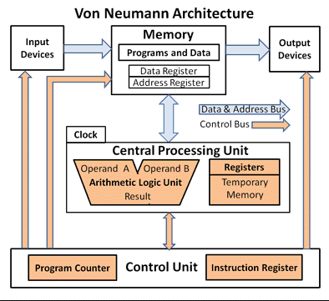
Computing Model
Architecture
Processing Unit: arithmetic and logical operations
Control unit: instruction definition storage and management of the “state” of a program
Memory: Storage of data and instructions to be run as a process
External mass storage
Input and output

Slide 14
Neural Network Motivation
From David J. MacKay, Information Theory
Biology: The task of understanding how the brain works in one of the outstanding unsolved problems in science. Some neural network models are intended to shed light on the way in which computation and memory are performed by brains.
Engineering: Many researchers would like to create machine that can `learn`, perform `pattern recognition` or `discover patterns in data`
Complex Systems: Analysis in neural networks has applications to other fields, is analogous to other complex system and has similar properties

Slide 15
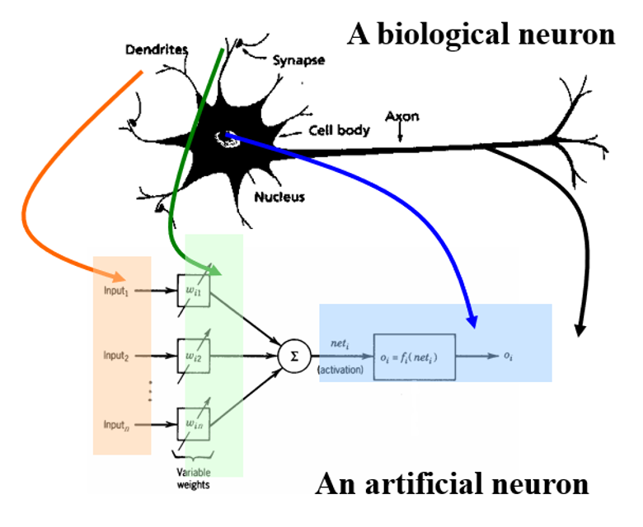
Neurons and Synapses
Biological:
Dendrites
Synapses
Cell Body
Axon
Artificial:
Input channels
Functions/state
Output channel

Slide 16
Neurons and Synapses
Main Concepts:
Transmission of Information: Hodgkin and Huxley built a model of the cell membrane: Sodium/Potassium ions and action potential
Information Processing: Neurons process info. at the membrane -> signal combination and thresholding occurs
Storage of Information: Information stored at the synapses, NMDA receptors and thresholding
Terminology: Abstraction of neuron and elementary process -> computing unit
Here arises our “primitive” notion and relationship to mathematical modeling of computation
Notes:
NMDA receptors: Mg ions block entrances to membrane, raising or lowering threshold to fire. NMDA receptors can be reset and “trained” to maintain the optimal permeability
With these concepts in mind, a representation that arises will need to consider the multiple input, some weighting system to consider some inputs with higher or lower importance, a way to combine the inputs and then convert the aggregate into a stimulus to create a spiking output
The mathematical formulation of these concepts leads to a nice representation

Slide 17
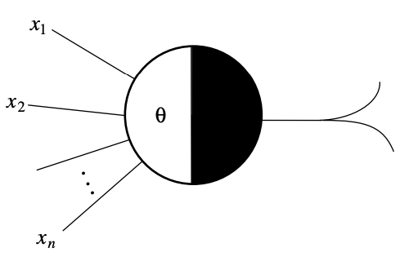
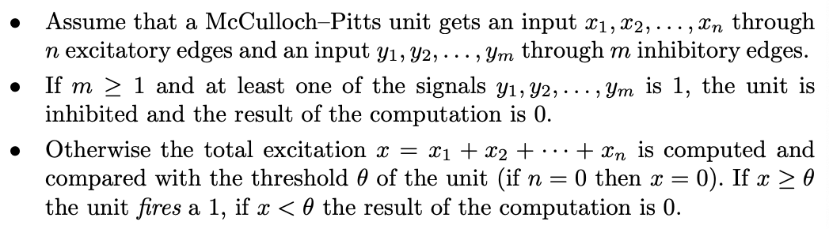
McCulloch-Pitts Neuron
The McCulloch-Pitts Neuron (MP Neuron)
Takes as input {0,1} for excitatory and inhibitory edges, outputs {0,1} according the following rules:

Slide 18
Neurons and Synapses
The McCulloch-Pitts Neuron (1943) developed by Warren McCulloch (Neurophysiologist) and Walter Pitts (Logician)
“A Logical Calculus of Ideas Immanent in Nervous Activity” (1943)
“One more thing is to be remarked in conclusion. It is easily shown: first, that every net … can compute only such numbers as can a Turing machine; second, that each of the latter numbers can be computed by such a net; and that nets with circles can be computed by such a net; and that nets with circles can compute, without scanners and a tape, some of the numbers the machine can, but no others, and not all of them. This is of interest as affording a psychological justification of the Turing definition of computability and its equivalents, Church’s A-definability and Kleene’s primitive recursiveness: if any number can be computed by an organism, it is computable by these definitions, and conversely.“
Notes:
Let’s take a look at one of the first implementation of the neuron:

Slide 19
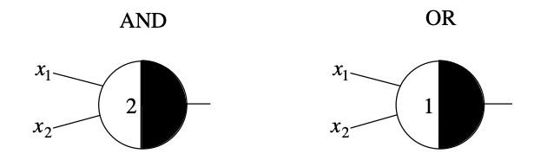
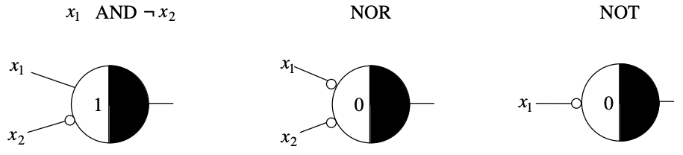
Neurons and Synapses
Relationship between MP Neurons and boolean functions:

Slide 20
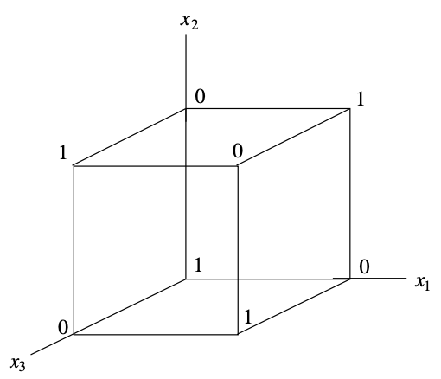
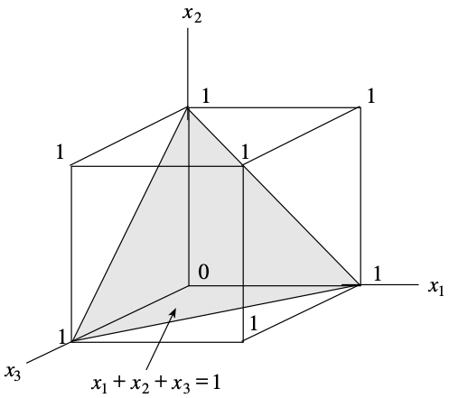
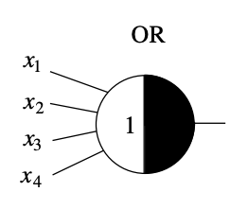
Neurons and Synapses
MP Neurons: For 3D case, we can visualize the lattice for the logical function being represented by the MP Neuron and also create a decision surface!

Slide 21
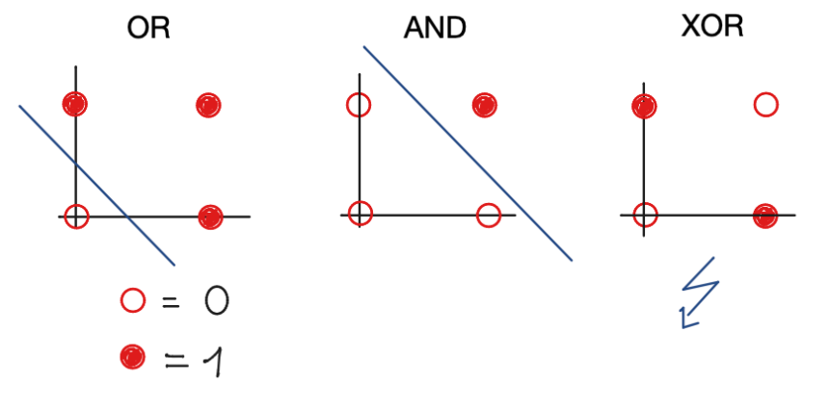
Neurons and Synapses
Problem: Since the MP Neuron creates a surface that divides the input space in two (can generalize to n-dims), a major consequence was then how can MP Neurons be used to calculate the XOR function?
Notes:
Nonetheless, the model was improved upon by Frank Rosenblatt and extended

Slide 22
Neurons and Synapses
Summary of MP Neuron issues:
XOR issue
All inputs are equally weighted
Function being represented needs to be defined manually:
Networks are built by construction since there is no “learning” algorithm (yet)
Some constructive algorithms exist but are costly to implement
Absolute inhibition rule is too restrictive (single firing input can overrule the other inputs and change the output)
MP Neurons are improved by Frank Rosenblatt!
Notes:
Nonetheless, the model was improved upon by Frank Rosenblatt and extended

Slide 23
Perceptron
Perceptron Motivation: Rosenblatt wanted to extend some concepts of Hebbian theory to the MP Neuron. Hebbian theory is concerned with how neurons are adapted during the process of learning
New formulation: Extend the discrete {0,1} values of the MP Neuron to the real line, replace the inhibitory input with the new rule that negative number input is allowed, add in bias term.
Finally: Inclusion of an algorithm for self learning

Slide 24
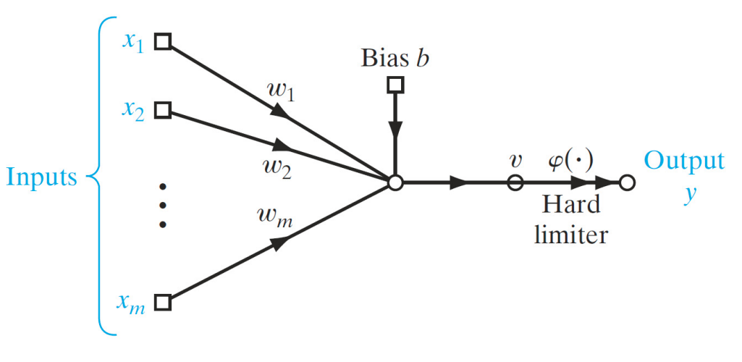
Perceptron
Definition for a perceptron

Slide 25
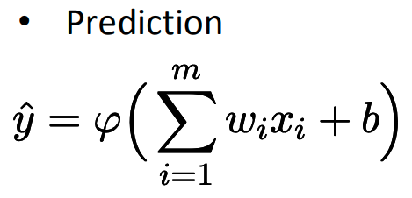
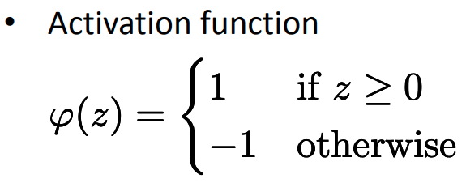
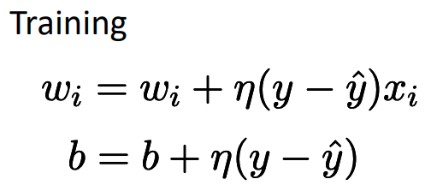
Perceptron
Single Layer Perceptron (1958):
Computation graph is equivalent to equation of a hyperplane, rules to update equation based on the networks classification prediction

Slide 26
Perceptron
Perceptron learning algorithm general cases:
True positives and True negatives:
Network predicts 1 and the correct value is 1
Network predicts 0 and the correct value is 0
False positives and False negatives
Network predicts 1 and the correct value is 0
Network predicts 0 and the correct value is 1

Slide 27
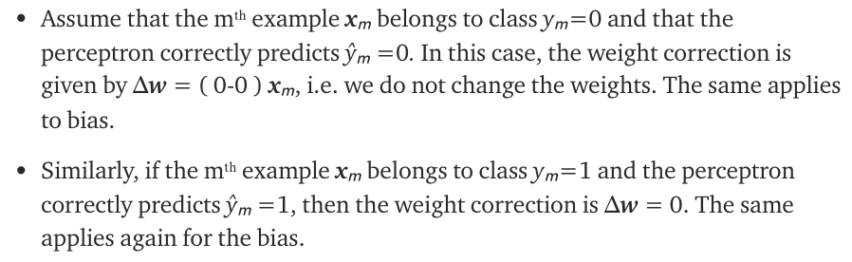
Perceptron
True Positives and True Negatives:

Slide 28
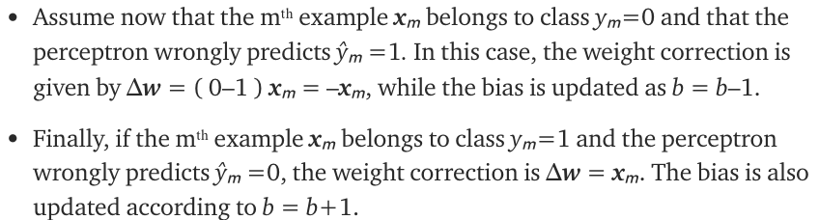
Perceptron
False Positives:

Slide 29
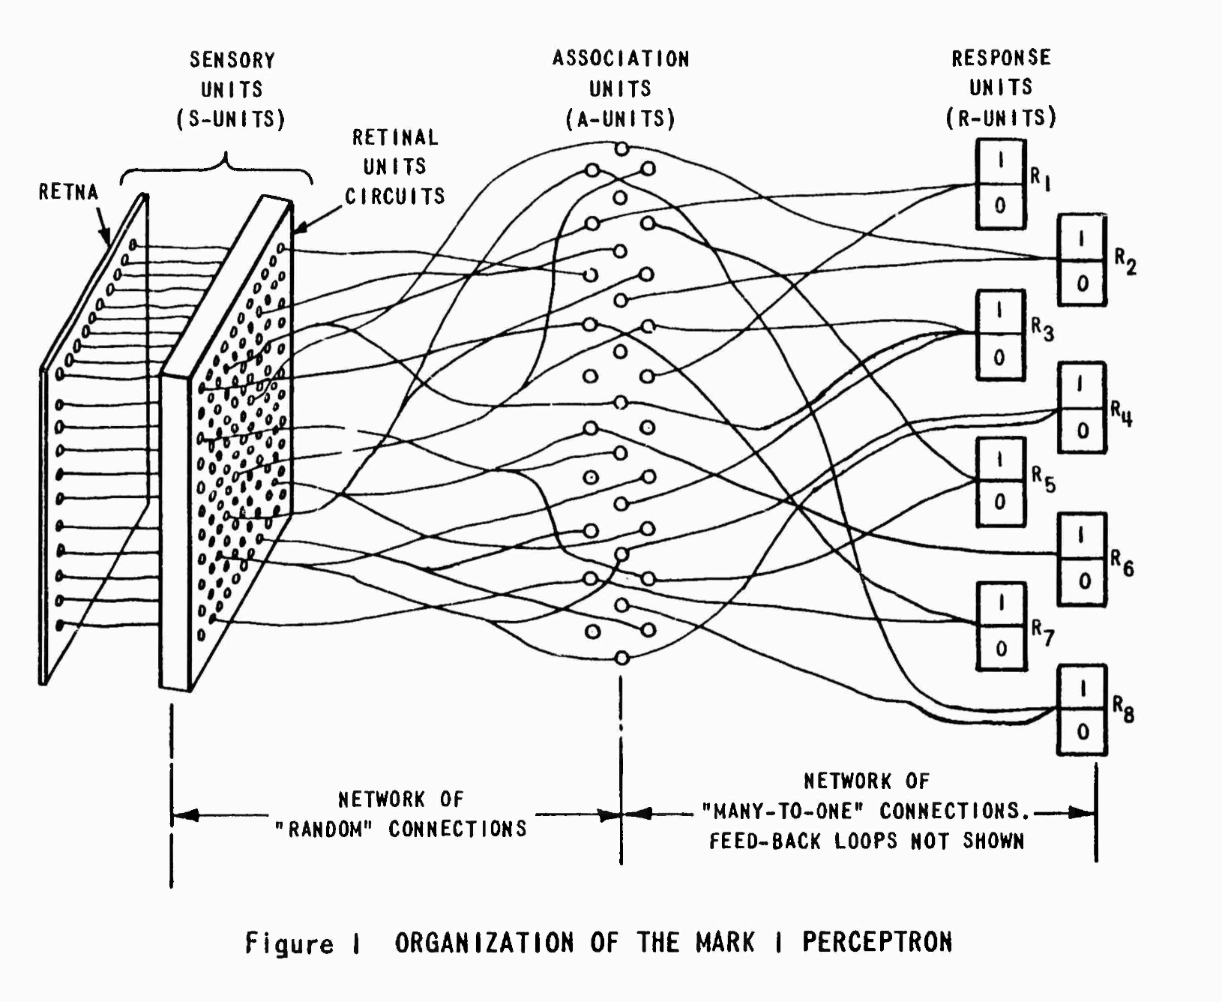
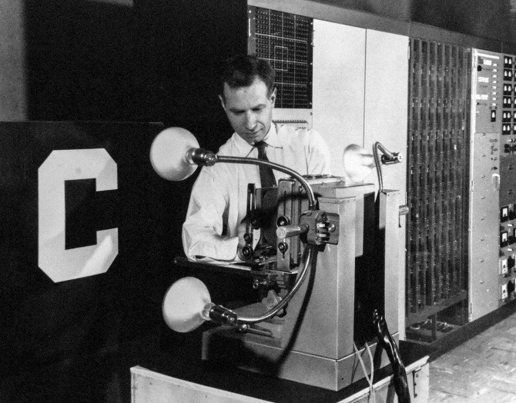
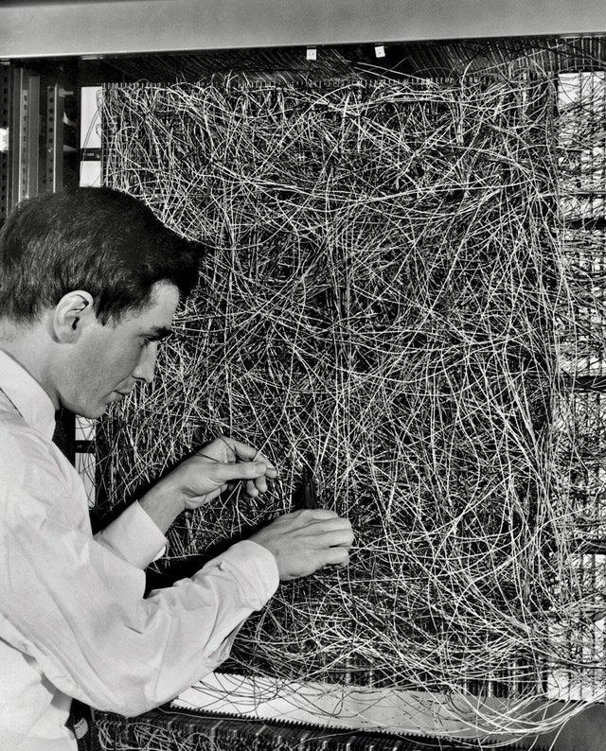
Perceptron
Rosenblatt shows that if classes are linearly separable, the perceptron learning algorithm will converge and the perceptron is able to classify the classes correctly. Mark 1 Perceptron machine is built at Cornell and implemented

Slide 30
Perceptron
Problems:
Despite the success of the Perceptron, it was still unable to learn the XOR function: Minsky and Papert in “Perceptrons: An Introduction to Computational Geometry” (1969)
General lack of efficient learning algorithms
Unfortunately:
Created a lull in the research being done with perceptrons and other work related to artificial neurons until the creation of the layered-perceptrons and networks
Research focus transferred back to symbolic approaches for learning…

Slide 31
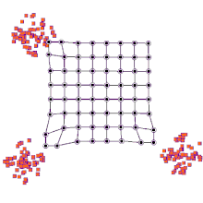
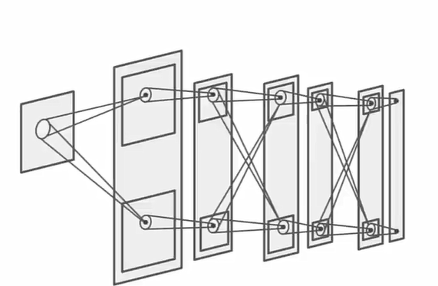
State of Research in 70s and 80s
Research community won’t return focus back to the field until the 80’s:
Some improvements made in the meantime:
Paul Werbos: Back Propagation as a learning mechanism
Teuvo Kohonen: Self Organizing map “Kohonen network”
Kunihiko Fukushima: “Neocognitron”
Kohonen Network
Neocognitron
Notes:
Kohonen Network: Efficient learning algorithm and simple approach that handles clustering and mapping high dimensional data to lower dimensions
Neocognitron: Successful implementation of a character recognition system: Built to recognize japanese characters. Based on work by Hubel and Wiesel from their work in biology

Slide 32
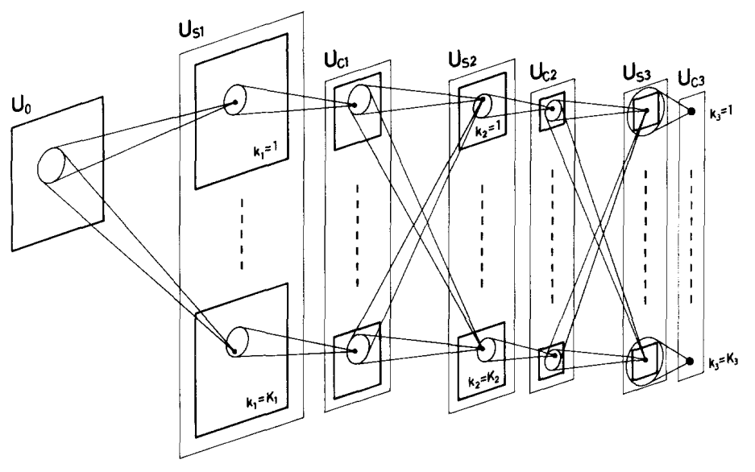
Neocognitron
Biological motivation: Layers of “S-cells” which are simple / lower order cells. Layers of “C-cells” which are complex / higher order cells

Slide 33
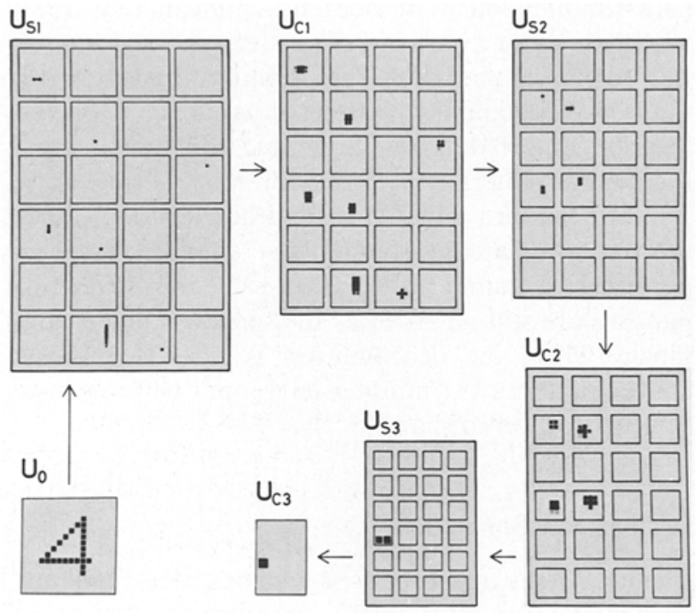
Neocognitron
Self Organization: Representative S-cells are taken from each S-layer for each pattern, S-cell chosen according to largest output. Input weights to the S-cell are reinforced the same way
S-columns: layers of S-layers, groups of S-cells are an S-layer. Highest output S-cell in S-column is the representative
C-cells respond when at least one of the S-cells has a large output => when an S-cell organized for a feature spikes in some region of the images
Notes:
Pg. 198 https://www.rctn.org/bruno/public/papers/Fukushima1980.pdf

Slide 34
Associative pattern recognition
Associative Pattern Recognition: Goal of associating a known input and output vector with each other, network is trained to also map the neighborhoods of input vectors to a neighborhood of the output vector
Main network types:
Heteroassociative networks: map m input vectors in n dims to m vectors in k dims.
Pattern Recognition networks: each input vector is associated with a scalar, goal of the network is to identify the “name” of the input pattern vector

Slide 35
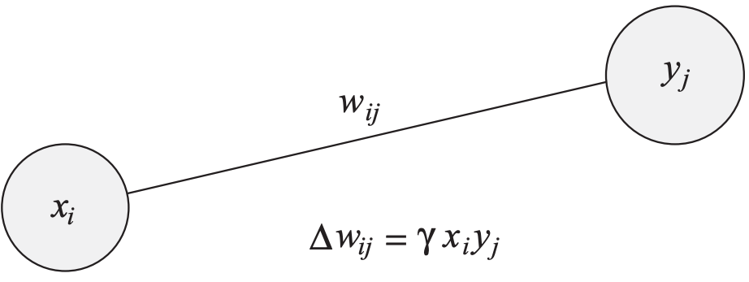
Associative pattern recognition
Associative Network learning:
Donald Hebb (1949): Two neurons which are simultaneously active should develop a degree of interaction higher than those neurons whose activities are uncorrelated.

Slide 36
Hopfield Network
Hopfield Network (1982): Cells connected to each other with weights forming a graph, sequentially update the states for each cell at random according to a rule that determines the state which minimized the “global energy”
Hopfield proposed that the memories can be captured by the minima of the net!
Can store patterns as a boolean string of 0,1’s. Can store exponentially many patterns as a function of the number of states
Isomorphism to the Ising models, equivalence to Perceptron learning too!
Convergence is proved, network guaranteed to find minimum energy state
Finds minimum to the travelling salesman problem (graph theory / opt.)
Hopfield Networks is all you need (2020): Permutation invariant, can replace GRU and LSTM layers, can act as an attention layer

Slide 37
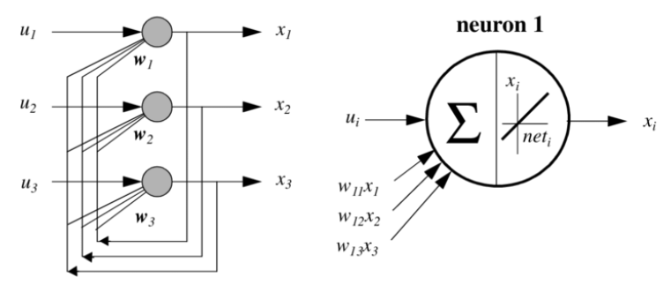
Hopfield Network
Todo: need network definition and vars, add info on update rule from hebbian learning idea and include info on threshold on output
https://en.wikipedia.org/wiki/Hopfield_network#:~:text=A%20Hopfield%20network%20(or%20Ising,Lenz%20on%20the%20Ising%20model.

Slide 38
Boltzmann Machine
Boltzmann: Extension of the Hopfield network which allows for stochastic weights. Allows for parallelization of the update step and also for better convergence due to the equilibrium of the network now defined probabilistically instead of requiring a summation and discrete local minima
Precursor to deep belief networks and variational autoencoders

Slide 39
Backpropagation
Until now, most of the common networks have been shown to handle tasks like learning boolean function and some simple pattern recognition tasks, the capabilities of these networks has been improved over time by the research community and several large projects have been undertaken to implement topics in this field.
However, computational requirements held the field back due to constraints on the sizes of networks: topologies and numbers of parameters were capped
Backpropagation algorithm (1985): Method for training neural networks, leverages a fast differentiation of a class of functions for computing the gradient of a network’s loss wrt to the learned weights.
Revamps research interest into neural networks!

Slide 40
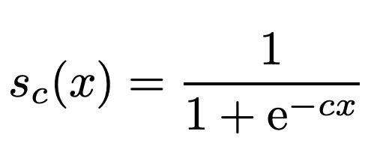
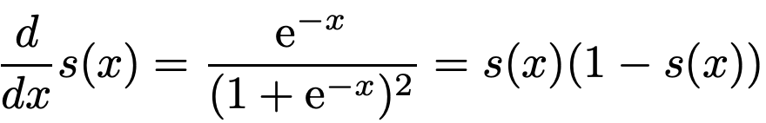
Backpropagation
At this point, most loss functions are defined piecewise, such as with the MLP where the loss is either -1, 0, or 1 depending on the variation. However, when considering the differentiability of the loss function, we need a new candidate function that has nice properties: continuous, threshold, differentiable.
Sigmoid Function:
Derivative:
Notes:
A review of how gradient descent works here before introducing backpropagation would be nice.

Slide 41
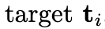
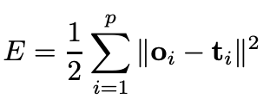
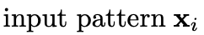
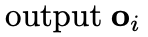
Backpropagation
Now, consider multiple perceptrons, arranged in a network with the sigmoid function as an activation. We can think of this network as a large function composition, the general case “learning” problem is for the network to update the weights during training so that the network is able to approximate some arbitrary function through a collection of the functions input and output values.

Slide 42
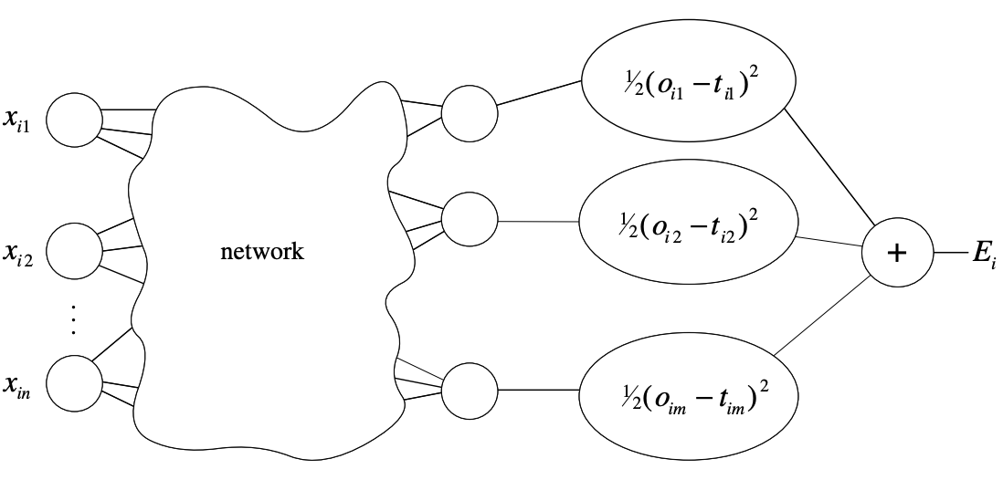
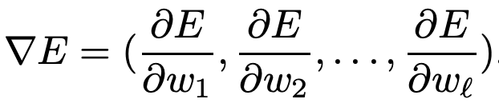
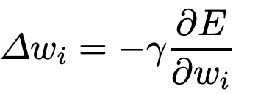
Backpropagation

Slide 43
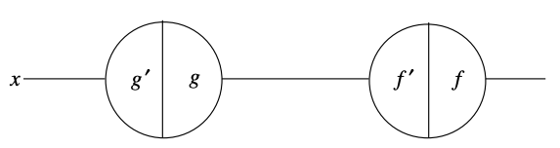
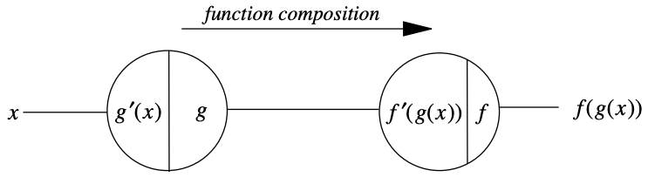
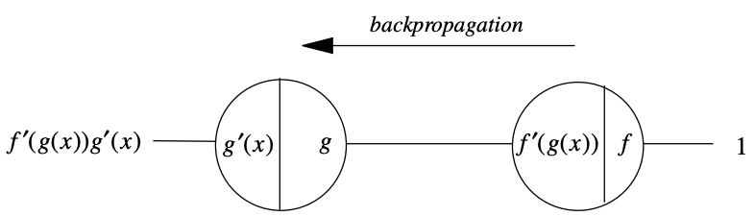
Backpropagation Network Model
Function and derivatives stored in nodes
Feed forward step: apply right side function of node to input. (Right to Left)
Backprop step: apply left side function of node to input. (Left to Right)

Slide 44
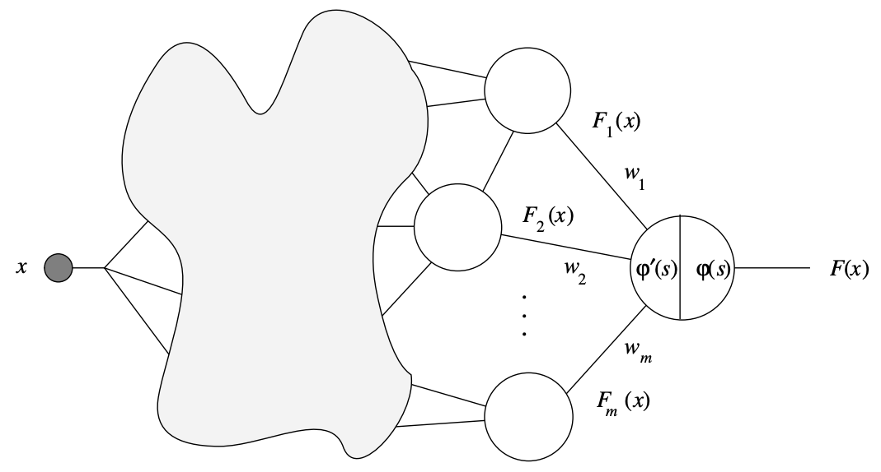
Backpropagation Network Model
Notes:
Proof by induction explanation

Slide 45
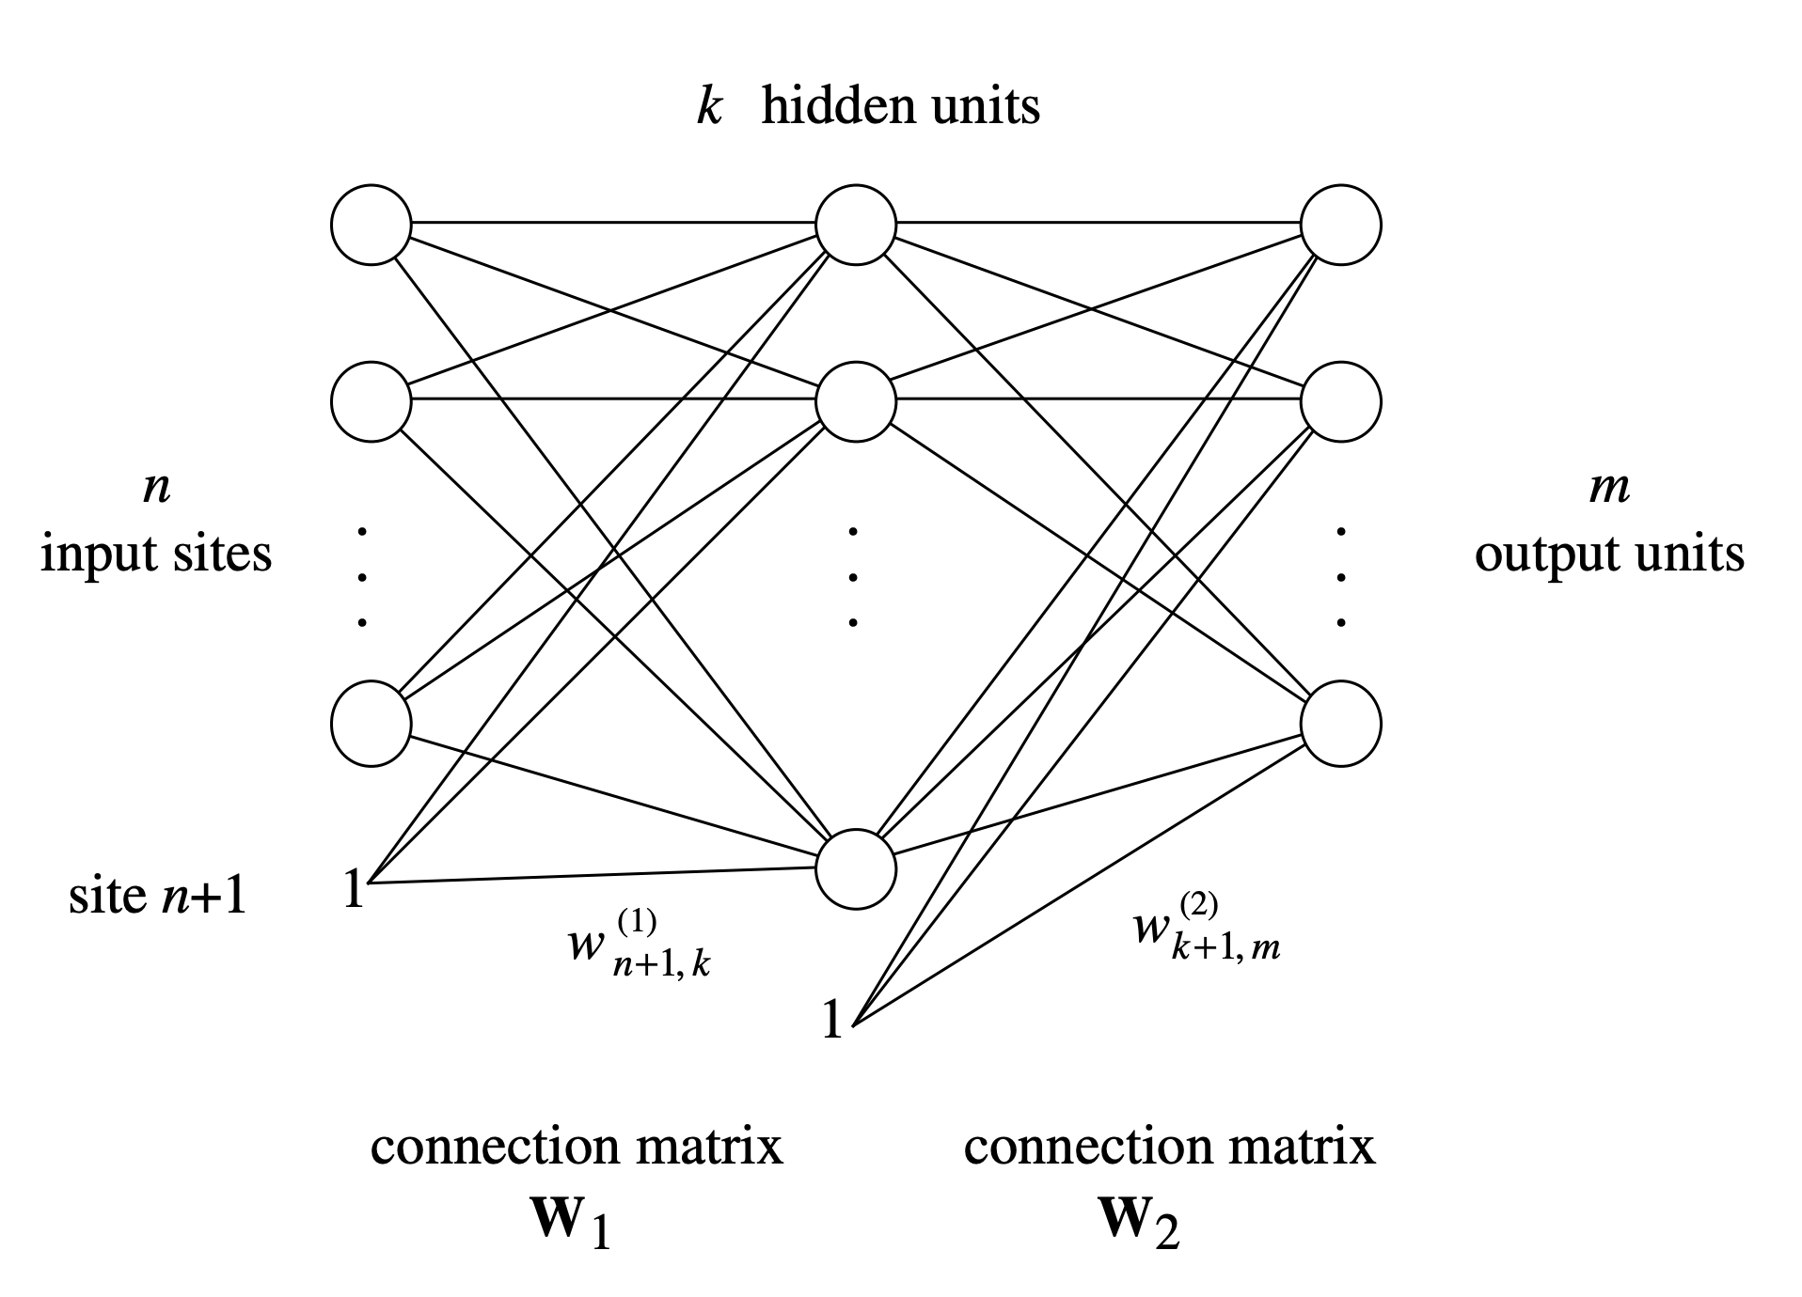
Backpropagation Network Model
Notes:
Proof by induction explanation

Slide 46
Backpropagation Network Model
Backpropagation algorithm for a two layer network:
Feed-forward computation
Backpropagation to the output layer
Backpropagation to the hidden layer
Weight updates
Stop when the error function has “converged”
Notes:
Proof by induction explanation

Slide 47
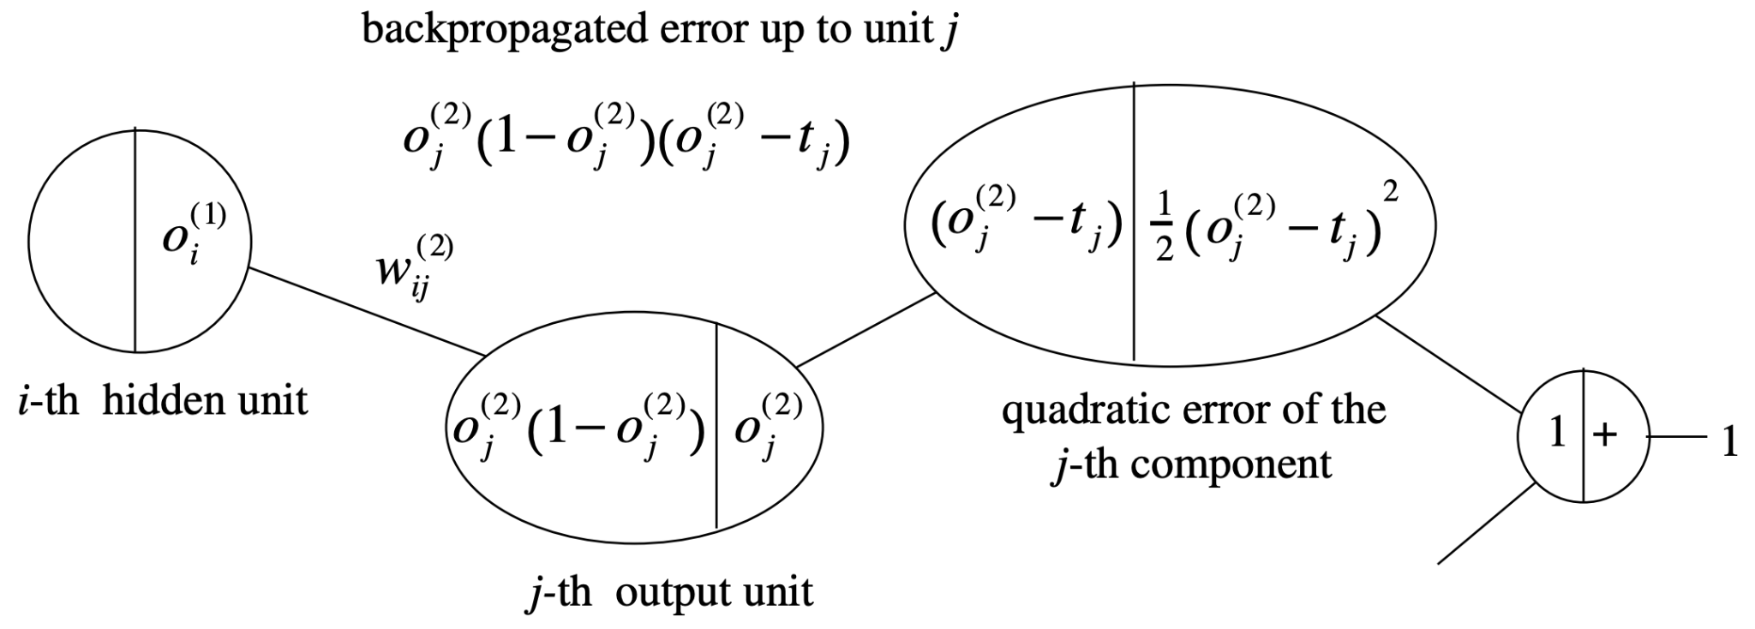
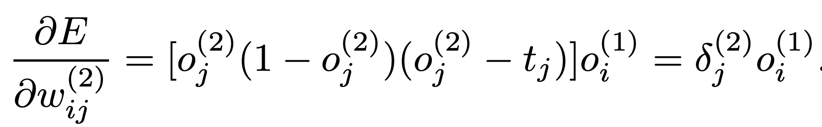
Backpropagation to the Output Layer
Notes:
Remembering the graph from before, forward pass is the right side, backwards pass is the left side. Therefore teh

Slide 48
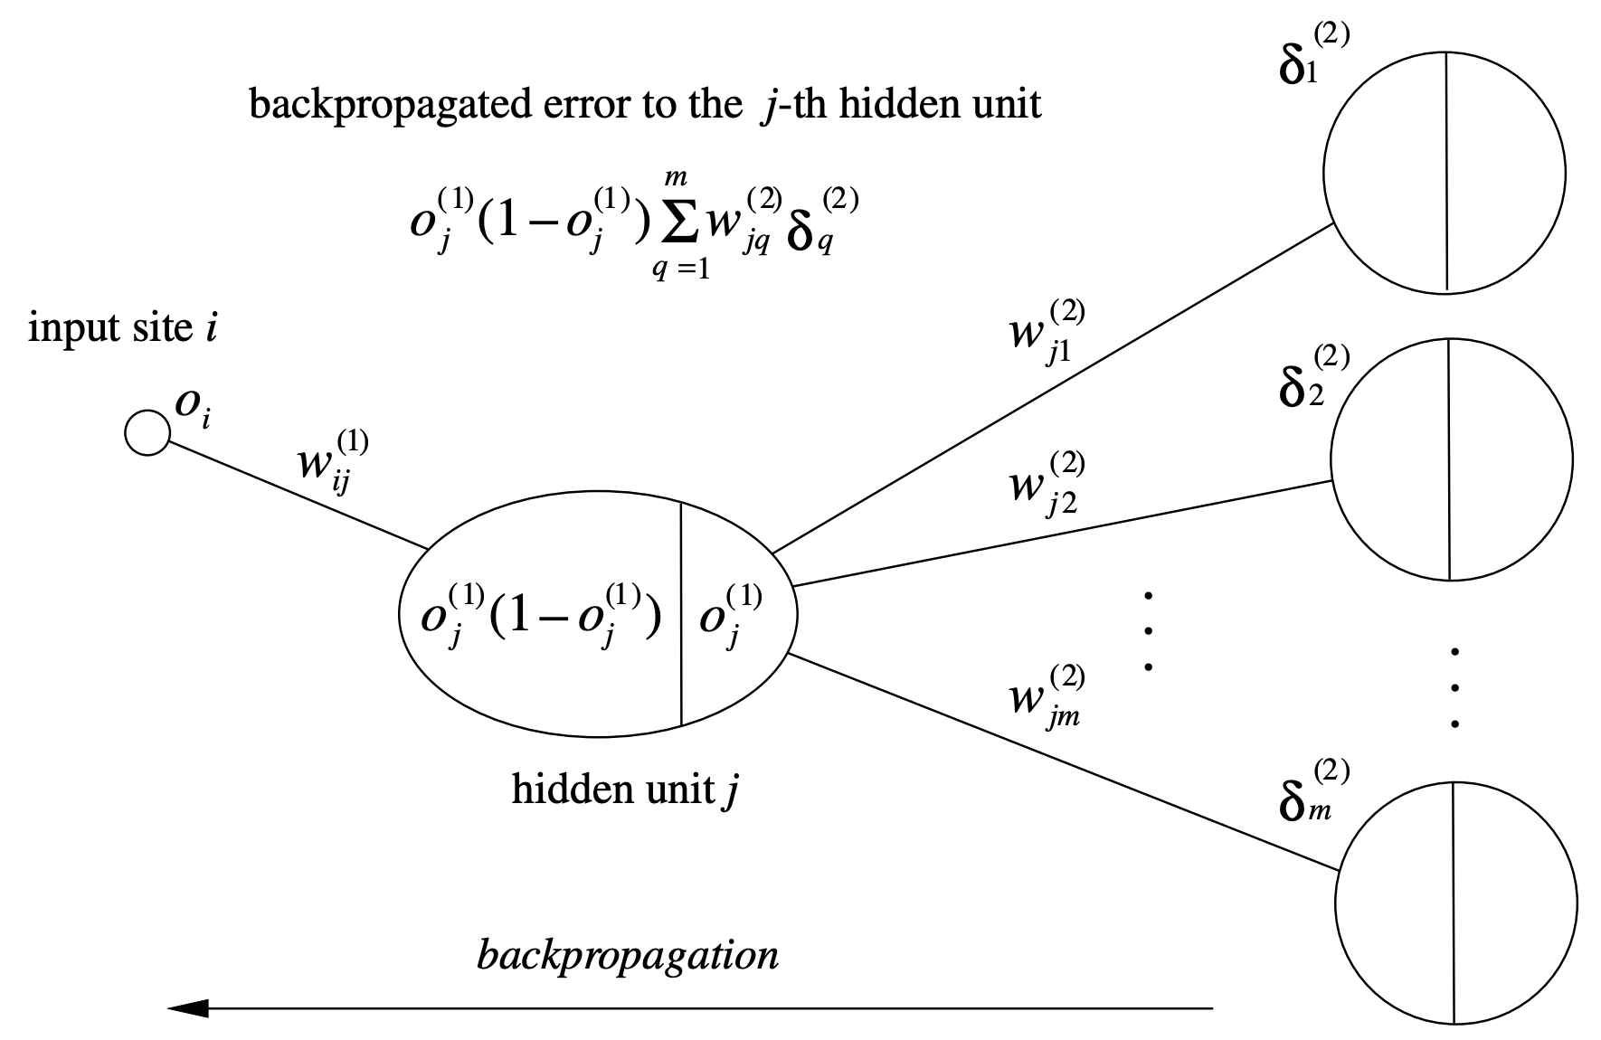
Backpropagation to the Hidden Layer
Notes:
Remembering the graph from before, forward pass is the right side, backwards pass is the left side.
Back-propagated error to a node: delta

Slide 49
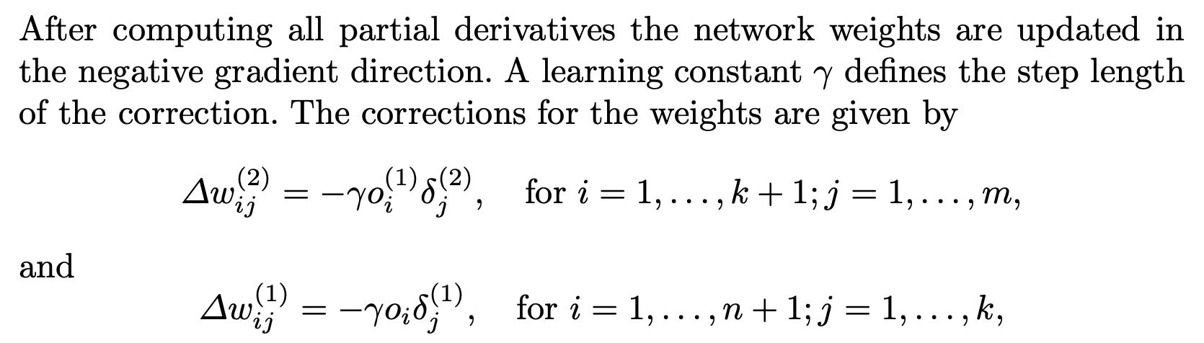
Weight Updates

Slide 50
Backprop
Combination of the advancements made:
Perceptron combined to formed layers, layers combined to create network
Backpropagation algorithm improved efficiency of training
XOR problem is finally solved, reassuring research community, many new successful applications in industry: ALVINN, NETtalk, Zipcodes
New focus on faster training and modifications
Backpropagation with momentum
Random weight initialization
Clipping derivatives
Different Losses and Activation functions
Notes:
ALVINN (1989): Autonomous land vehicle in a neural network self driving car at CMU, most moving to google to continue to work on self driving cars
NETtalk: Terrence Sejnowski and Charles Rosenberg: Network learns to pronounce written english text by learning english words and phonemes pairs. Goal is to learn proper associations of phonemes with letters based on the context of letters
Zipcode network: Le Cun at Bell Labs: Post office zipcode character recognition

Slide 51
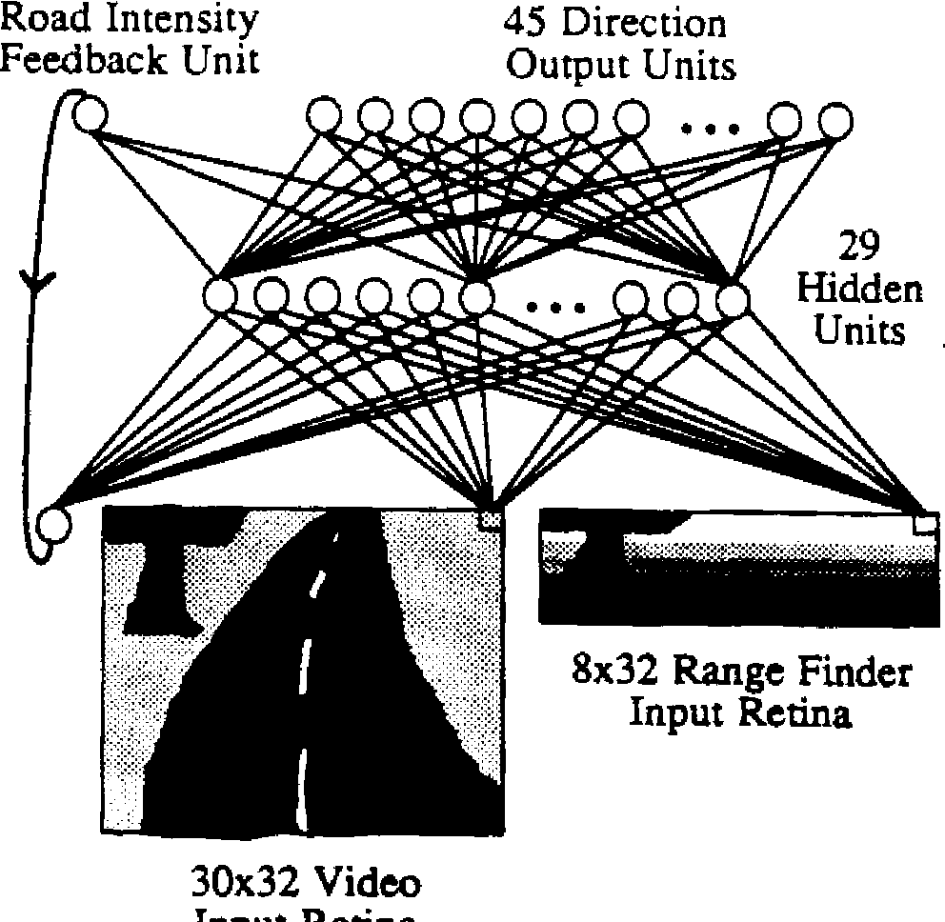

ALVINN
Notes:
ALVINN (1989): Autonomous land vehicle in a neural network self driving car at CMU, most moving to google to continue to work on self driving cars
NETtalk: Terrence Sejnowski and Charles Rosenberg: Network learns to pronounce written english text by learning english words and phonemes pairs. Goal is to learn proper associations of phonemes with letters based on the context of letters
Zipcode network: Le Cun at Bell Labs: Post office zipcode character recognition

Slide 52

Nettalk network
Notes:
ALVINN (1989): Autonomous land vehicle in a neural network self driving car at CMU, most moving to google to continue to work on self driving cars
NETtalk: Terrence Sejnowski and Charles Rosenberg: Network learns to pronounce written english text by learning english words and phonemes pairs. Goal is to learn proper associations of phonemes with letters based on the context of letters
Zipcode network: Le Cun at Bell Labs: Post office zipcode character recognition

Slide 53

Zipcode network
Notes:
ALVINN (1989): Autonomous land vehicle in a neural network self driving car at CMU, most moving to google to continue to work on self driving cars
NETtalk: Terrence Sejnowski and Charles Rosenberg: Network learns to pronounce written english text by learning english words and phonemes pairs. Goal is to learn proper associations of phonemes with letters based on the context of letters
Zipcode network: Le Cun at Bell Labs: Post office zipcode character recognition

Slide 54

Zipcode network
Notes:
ALVINN (1989): Autonomous land vehicle in a neural network self driving car at CMU, most moving to google to continue to work on self driving cars
NETtalk: Terrence Sejnowski and Charles Rosenberg: Network learns to pronounce written english text by learning english words and phonemes pairs. Goal is to learn proper associations of phonemes with letters based on the context of letters
Zipcode network: Le Cun at Bell Labs: Post office zipcode character recognition

Slide 55

Types of Activation Functions

Slide 56

Types of layers
Fully connected: All nodes in layer k-1 are connected to all nodes in layer k

Slide 57

Types of layers
Convolution: Sliding dot product over input using kernel or filter

Slide 58

Types of layers
Pooling Layers: Application of function to aggregate input

Slide 59


Types of layers
Upsampling Layers: Application of function to “expand” input

Slide 60
Autoencoder Networks
Autoencoder: Two stage neural network for compressing and re-creating input
Encoder: the first stage compresses the input into a “latent” representation
Decoder: the second stage then expands the latent representation into a prediction of the original input.
Network Goal: learn structure within the data, discover an encoding. Main concepts: reducing dimensionality and information retrieval
Training: Treat pairs of layers like Boltzmann machines, train layers’ ability to reconstruct input, then finetune entire network with backpropagation (Deep Belief Networks)

Slide 61

Autoencoder Networks
Notes:
If linear activations are used, then optimal solution is strongly related to PCA: The weights of an autoencoder with a single hidden layer of size {\displaystyle p}p (where {\displaystyle p}p is less than the size of the input) span the same vector subspace as the one spanned by the first {\displaystyle p}p principal components, and the output of the autoencoder is an orthogonal projection onto this subspace. The autoencoder weights are not equal to the principal components, and are generally not orthogonal, yet the principal components may be recovered from them using the singular value decomposition

Slide 62
Autoencoder Networks
Applications of Autoencoders:
Dimensionality Reduction: Mapping to a lower dimensional representation
Image Compression: Learning a vector representation of images
Image Denoising: Removing artifacts of an image that aren’t consistent with the image’s main content
Feature Extraction: Using latent representation of the input as a feature for other applications such as clustering

Slide 63

Recurrent Neural Network (RNN)
Recurrent Neural Network: Class of neural networks that takes as input, the output of some subset of the network at a previous timestep

Slide 64
Recurrent Neural Network (RNN)
RNN Applications: Sequence Processing!
Language Modeling: Given and input sequence of words, predict the output sequence
Speech Recognition: Given acoustic signal of phonemes, predict the phonetic segments
Machine Translation: translation from one language to another
RNN Issue: Hard for RNN’s to consider information from many timesteps ago due to the vanishing gradient issue

Slide 65


Long Short-Term Memory (LSTM)
Motivation: Modify the RNN architecture to be less sensitive to input further from the current timestep during training
Notes:
C state: can read from it, write to it or reset it
Green: input gate: Controls if the cells is updated
Yellow: forget gate: Controls if the memory gate is reset to 0
Red: output gate: Controls if the state of the current gate is visible

Slide 66
LSTM Successes
2001 Gers/Schmidhuber trained LSTMs to learn languages
2005 Graves/Schmidhuber backprop through time and bi-directional LSTM
2006 New error function Connectionist Temporal Classification (CTC) leeds to breakthroughs in speech applications
2009 LSTM wins ICDAR handwriting recognition competition
2013 Graves/Mohamed/Hinton use LSTMs in net that achieves record 17.7% phoneme error on TIMIT natural speech dataset
2015 Imagenet 2015 won using Residual Neural Network, becomes most cited network of 21st century

Slide 67
LSTM Successes
2016 Google Neural Translation released, reduces errors by 60%. Apple announces it will use LSTMs for quicktype and Siri. Amazon releases Polly bi-directional LSTM for text-to-speech
2017 Facebook is performing 4.5 billion automatic translations every day with LSTMs!
2018 OpenAI beats humans in Dota 2. Uses a 1024 unit LSTM
2019 DeepMind’s AlphaStar uses a deep LSTM core to play Starcraft II

Slide 68
Generative Adversarial Networks
Generative Adversarial Neural Network: System in which two networks are simultaneously trained, one to discriminate between real images and generated images (from the 2nd network) and the other network to generate images that aren’t discernable from real images (by the 1st network)
Applications:
Generating Art / Video Games: Edmond de Belamy / Final Fantasy
Synthetic data
In Physics to model certain energies
Celebrity Deepfakes

Slide 69

Generative Adversarial Networks

Slide 70

Generative Adversarial Networks

Slide 71
Transformers
Transformer: Similar to RNNs however the entire input can be processed at the same time, with an “attention mechanism” used to weight the significance of each input.
Seen as improvement over LSTMs
Led to development of:
BERT (Bidirectional Encoder Representations from Transformers)
GPT (Generative Pre-trained Transformer)
Notes:
BERT BASE: 12 encoders and 12 bi-directional self attention heads
BERT LARGE: 24 encoders with 16 bidirectional self attention heads
BooksCorpus 800M words and Wikipedia w 2.5B words
SOTA on:
GLUE (general language understanding evaluation)
SQuAD (stanford question answering dataset)
SWAG (situations with adversarial generations)
Sentiment Analysis, sentiment analysis classifier using BERT reached high performance
2019/2020 Google adopted BERT for english queries, then scaled to over 70 languages
345 million parameters
GPT3 175 billion params
Can generate entire articles given the titles
Can translate
Code auto-completion

Slide 72

Modern Computer Vision Architecture
VGG Architecture (VGG16):
image classification

Slide 73

Modern Computer Vision Architecture
Deep Residual Architecture (Resnet 50):
Use skip connections

Slide 74

Modern Computer Vision Architecture
Yolact Architecture for Instance/Semantic Segmentation

Slide 75

Modern Computer Vision Architecture
Instance/Semantic Segmentation

Slide 76

Modern Computer Vision Architecture
Maskrcnn Architecture for Instance/Semantic Segmentation

Slide 77
Neural Nets
RNNs
LeNet
LSTMs
Deep Belief Networks
Deep Boltzmann Machines
Dropout and regularization (Hinton)
GANs
Capsule Networks
Reinforcement Learning
Attention
RPNs
Segmentation
Show examples of applications of deep learning
Speech
Vision
Natural language
Proteins / Pharma
PDEs
Compression
Music etc
DALLE2
GPT3

